Slide 1



TR# 2017325

Slide 2



SYSTEMS
OVERVIEW
2 - Systems Overview
T-Mobile confidential and proprietary information. Not for customer distribution.

Slide 3
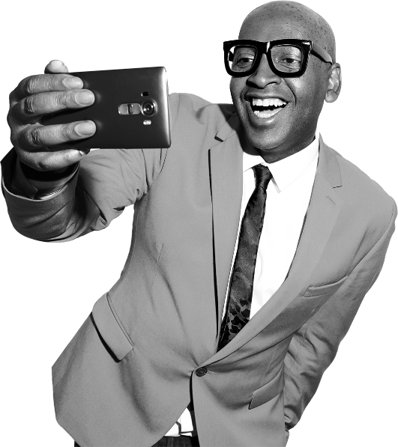
INTRO
Watson
Point of Sale (POS)
QuikView
3 - Systems Overview
T-Mobile confidential and proprietary information. Not for customer distribution.

Slide 4


DO IT YOURSELF
15 MINS
WATCH
BOOKMARK
Go to the C2 DOC 433580 - Systems Simulations page and watch:
Account Audit
View Account Memos
EIP Device Purchase
Find and bookmark:
POS/mPOS:
C2 DOC 416472 - POS Transactions
C2 DOC 416124 - mPOS on REMO
C2 DOC 416650 - Bill Payments in Store
QuikView:
QuikView steps: https://c2.t-mobile.com/community/systems-steps/quikview-steps
4 - REMO
T-Mobile confidential and proprietary information. Not for customer distribution.

Slide 5

The Download
How can Watson, POS/mPOS and QuikView be used to provide an Un-carrier customer experience?
What Interaction Model Behaviors can a Mobile Expert demonstrate while using these systems?
What actions can be performed with the Watson, POS/mPOS and QuikView??
5 - Systems Overview
T-Mobile confidential and proprietary information. Not for customer distribution.

